Slide 1
Predicting the Solutions of Optimisation Models with Machine Learning
Mitchell Keegan
Supervised by Mahdi Abolghasemi
Notes:
Hi everyone, my name is Mitch, I’m studying a Masters in applied mathematics. This year for my thesis I’ve been looking methods of predicting the solutions to optimisation problems using machine learning models.

Slide 2
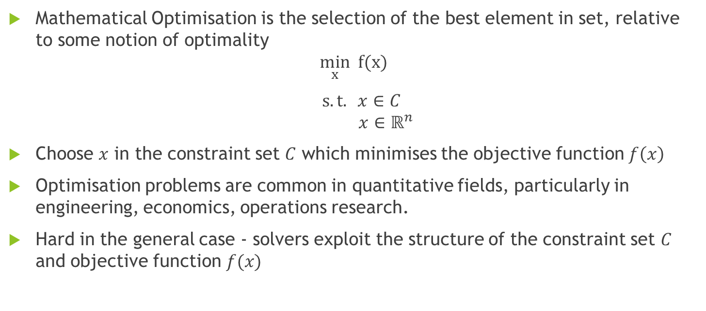
Mathematical Optimisation
Mathematical Optimisation is the selection of the best element in set, relative to some notion of optimality
$$\min_{x} f(x)$$
$s.t. x∈C$ $x∈ℝ^{n}$
Choose $x$ in the constraint set $C$ which minimises the objective function $f\left(x\right)$
Optimisation problems are common in quantitative fields, particularly in engineering, economics, operations research.
Hard in the general case - solvers exploit the structure of the constraint set $C$ and objective function $f(x)$
Notes:
I’ll start by defining what I mean by mathematical optimisation and machine learning. So starting with optimisation, the somewhat abstract definition is selecting the best element in given set relative to some notion of optimality. We model that is choosing the value of x in some set C which we call the constraint set, which minimises f(x) which we call the objective function.
In a lot of cases it might be easier to conceptualise optimisation in terms of decision making. So we might think of x as representing a decisions or a series of related decisions, which we’ll often refer to as decision variables. The constraint set then represents, constraints on what decision we can make, for example we might have limited resources available. The objective function would often be something like cost or profit or value, or some other metric we want to optimise.
These sort of problems pop up a lot in quantitative fields, engineering, economics, operations research and also computer science are big ones. But these ideas are really quite flexible in terms of what they can model so they tend to pop up in a lot different places.
In the general case solving this is really difficult. When people have developed algorithms for these problems is to impose some sort of structure on the objective function and the constraint set, and then exploit that structure to develop efficient solvers. Today we’re going to be focused on one particular type of optimisation problem called integer programming.

Slide 3
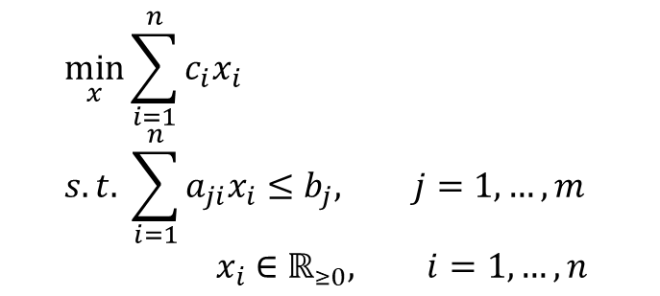
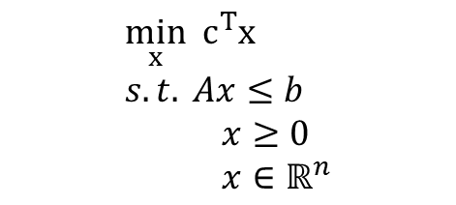

Integer Programming
Linear Programming – Linear objective function & constraints
$$\min_{x}{\sum_{i=1}^{n}{c_{i}x_{i}}} \\ s.t. \sum_{i=1}^{n}{a_{ji}x_{i}}≤b_{j}, j=1,…,m \\ { x}_{i} ∈ℝ_{≥0}, i=1,…,n$$
$$\min_{x} c^{T}x \\ s.t. Ax≤b \\ x≥0 \\ x∈ℝ^{n}$$
Integer Programming – Further restrict x to the integers
$$\min_{x} c^{T}x \\ s.t. Ax≤b \\ x≥0 \\ x∈ℤ^{n}$$
Notes:
So to introduce integer programming I’ll first introduce a related problem called linear programming, which is where the constraints and objective function have a linear structure. On the slide I’ve got two different representations. On the left we express our objective and constraints as a linear combinations of our decision variables, noting that we have m different constraints each with different coefficients. On the right is a more compact form where we wrap those linear combinations up into vectors and matrices. We’ll see both of these styles today using one or the other depending on which is more convenient.
To get to integer programming we’ll just restrict our decision variables to the positive integers, instead of the positive reals like we had above.

Slide 4
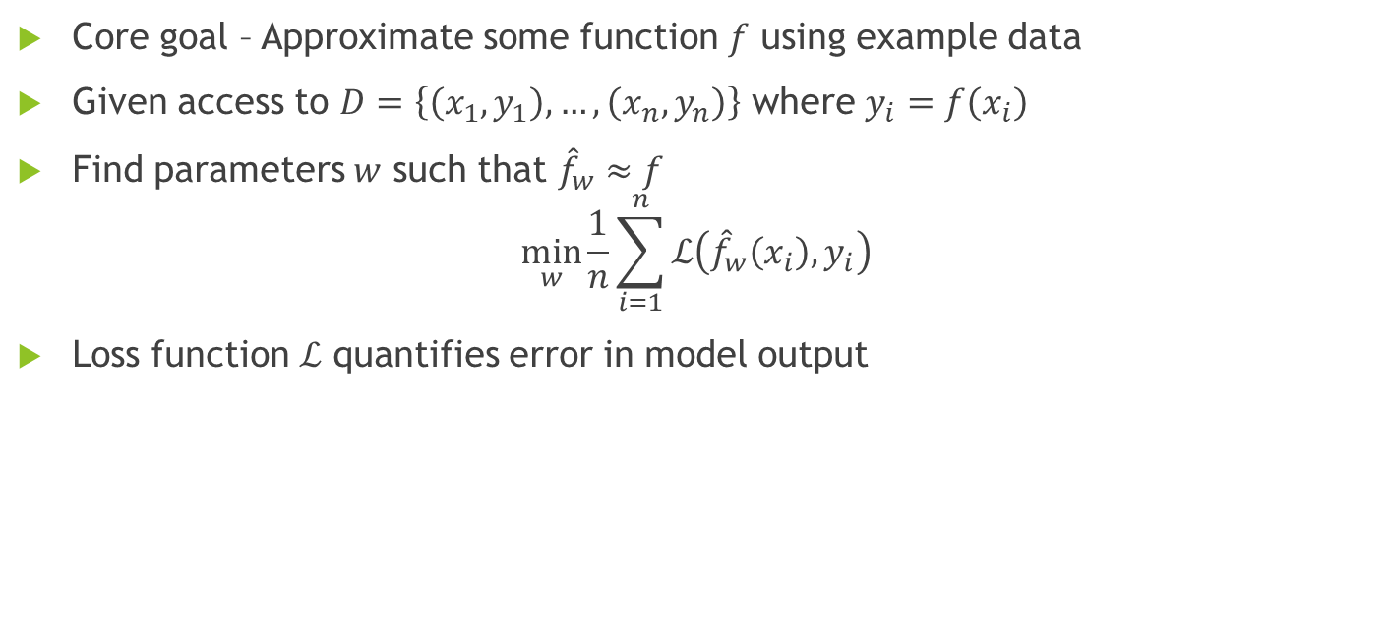
Machine Learning (Supervised Learning)
Core goal – Approximate some function $f$ using example data
Given access to $D=\left\{\left(x_{1},y_{1}\right),…,\left(x_{n},y_{n}\right)\right\}$ where $y_{i}=f\left(x_{i}\right)$
Find parameters $w$ such that ${\hat{f}}_{w}≈f$
$$\min_{w}{\frac{1}{n}\sum_{i=1}^{n}{ℒ\left({\hat{f}}_{w}\left(x_{i}\right),y_{i}\right)}}$$
Loss function $ℒ$ quantifies error in model output
Notes:
I’ll also give a very, very brief introduction to machine learning as relevant for today. I’ve been focusing on supervised learning, where the core goal is to approximate some function or relationship by using a large set of input/output data from that function to train a model. We’ll approximate that relationship by some function f hat, which is parameterised by weights which we’ll call w. To find those weights we’ll minimise the average loss over our training data, where the loss is this function L which quantifies the error in the predictions our model makes.

Slide 5
Machine Learning for Constrained Optimisation
Solving optimisation problems can be computationally expensive
Generating solutions may be infeasible under strict time constraints
Machine learning models may be able to able to approximate solutions at a much lower computational cost
Main Obstacles:
Generating training data may be infeasible
ML models are traditionally unable to enforce constraints on outputs
The Lagrangian Dual Framework (LDF) is one proposed method to encourage constraint satisfaction in predicted solutions
Notes:
One of the key drawbacks of optimisation problems is that they can be very computationally expensive to solve. This is especially true for integer programming problems. If you have a use case where you need solutions under strict time constraints this can be a serious problem. If you’re willing to sacrifice some accuracy one solution might be to use machine learning models to approximate solutions in a fraction of the time.
So if you want to use ML models to predict solutions to optimisation problems you have two main problems.
The first is that you might have a lot of trouble getting training data. The types of problems you’d be interested in are those which are difficult to solve, but you need to solve a significant amount of instances to generated labelled training data, recalling that you need input output pairs.
The second is that ML models don’t traditionally have any way to enforce, or even really encourage constraint satisfaction on the outputs other than the fact that training data should satisfy constraints. This means that there’s little incentive for predicted solutions to be feasible solutions.
There are a couple of methods which address this problem of constraint satisfaction, these approaches can be broadly categorised into reinforcement learning and supervised learning. I’ve been focusing on supervised learning, but reinforcement learning is a promising approach and also neatly sidesteps issues with generating data. Within supervised learning there are a few methods that some strong results on continuous optimisation problems. As far as I’m aware these methods haven’t been applied to integer programming problems and it’s not obvious how to apply these to integer programming.
I’m going to be talking about one particular method from the literature called the Lagrangian dual framework, or LDF for short, which is much better suited for integer programming problems and has been successfully applied to another IP problem called the job shop scheduling problem.

Slide 6
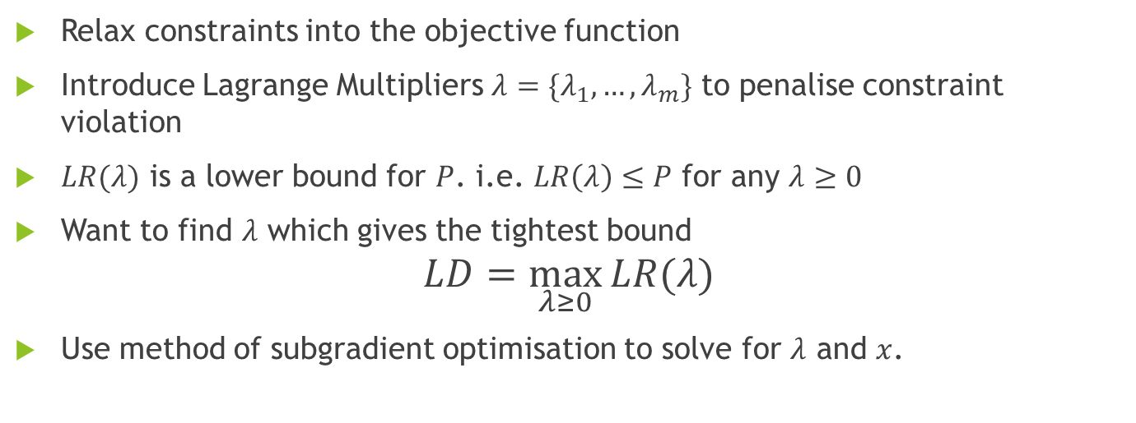
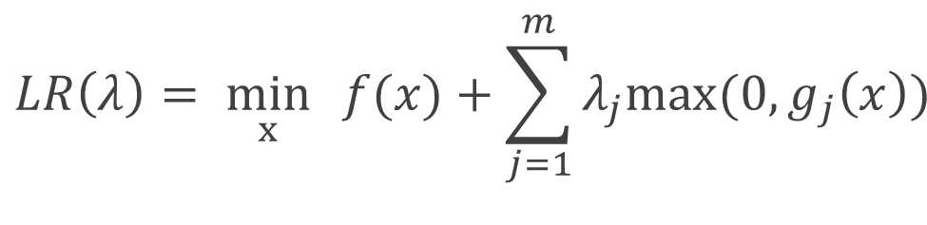
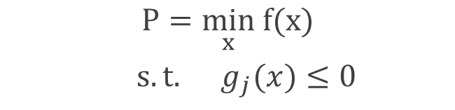
Lagrangian Relaxation
$$LR\left(λ\right)= \min_{x}{f(x)+\sum_{j=1}^{m}{λ_{j}max⁡({0,g}_{j}\left(x\right))} }$$
$P=\min_{x} f(x)$
$s.t. g_{j}(x)≤0$
Relax constraints into the objective function
Introduce Lagrange Multipliers ${λ=\{λ}_{1},…,λ_{m}\}$ to penalise constraint violation
$LR(λ)$ is a lower bound for $P$. i.e. $LR\left(λ\right)≤P$ for any $λ≥0$
Want to find $λ$ which gives the tightest bound
$$LD=\max_{λ≥0}{LR(λ)}$$
Use method of subgradient optimisation to solve for $λ$ and $x$.
Notes:
To explain how the Lagrangian dual framework works I first need to introduce the general idea of Lagrangian Relaxations.
On the left we have a general optimisation problem with inequality constraints. The idea is to turn this into an unconstrained optimisation problem, by incorporating the constraints into the objective function in such as way that any solutions which violates the constraints will increase the objective function. When some constraint g(x) is satisfied we’ll have that g(x) is less than zero, then the max of zero and g(x) is zero so it’ll have no effect on the objective function. If the constraint is not satisfied g(x) will be greater than zero and the max of zero and g(x) will be some positive number, the idea then is that the optimiser will work to satisfy the constraints as it tries to find the minimum.
We also introduce Lagrange multipliers, one for each constraint, denoted at lambda j for the jth constraint. These are penalties on constraint violations. If we think of this Lagrangian relaxation as being a function of lambda, it’s possible to show that for any lambda, the minimum of our Lagrangian relaxation is going to be a lower bound for the optimal objective from our constrained optimisation problem.
From here we might want to find the lambda which gives the tightest bound, and we can do that by forming the Lagrangian dual which is maximising the Lagrangian relaxation over lambda.
You can solve the Lagrangian dual using a method called subgradient optimisation. I won’t too much into this but the general idea is that we want to do something like gradient ascent to solve our maximisation problem, but since the Lagrangian relaxation is non-differentiable we won’t necessarily have a gradient at every point, and instead we use a generalisation of the gradient called subgradients. In a couple of slides we’ll see what this process actually looks like.
Q’s:
Why constraint violation over satisfaction?

Slide 7
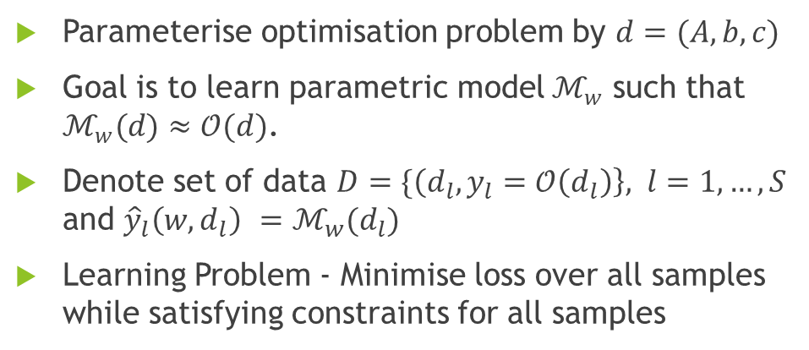
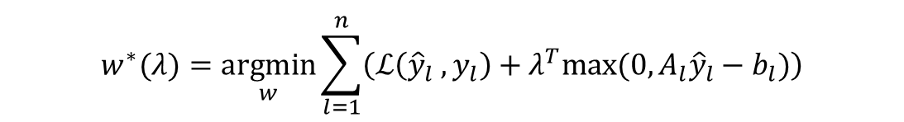
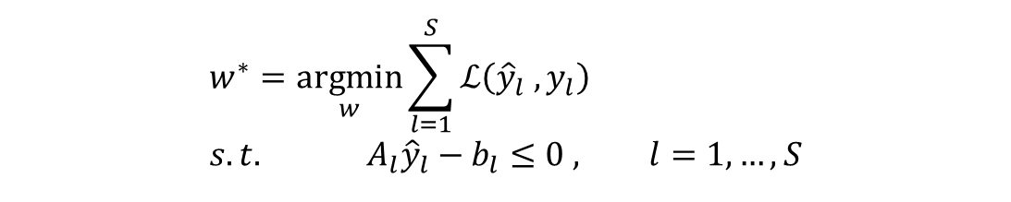
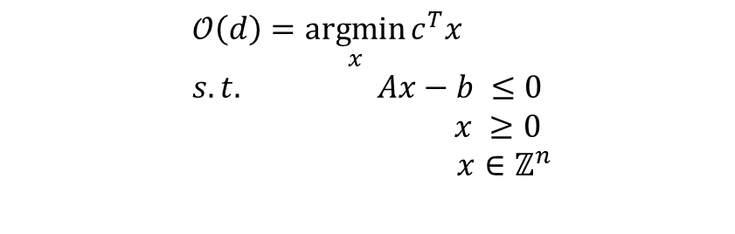
The Lagrangian Dual Framework
Parameterise optimisation problem by $d=(A,b,c)$
Goal is to learn parametric model $ℳ_{w}$ such that $ℳ_{w}(d)≈𝒪(d)$.
Denote set of data $D=\{\left(d_{l},y_{l}=𝒪\left(d_{l}\right)\right\}, l=1,…,S$ and ${{\hat{y}}_{l}\left(w,d_{l}\right) =ℳ}_{w}(d_{l})$
Learning Problem - Minimise loss over all samples while satisfying constraints for all samples
$$𝒪\left(d\right)=\underset{x}{argmin}{c^{T}x} \\ s.t. Ax−b ≤0 \\ x ≥0$$ $x∈ℤ^{n}$
$$w^{∗}=\underset{w}{argmin}\sum_{l=1}^{S}{ℒ\left({\hat{y}}_{l} ,y_{l}\right)} \\ s.t. A_{l}{\hat{y}}_{l}−b_{l}≤0 , l=1,…,S$$
Relax the constraints into the objective as before
$$w^{∗}(λ)=\underset{w}{argmin}\sum_{l=1}^{n}{\left(ℒ\left({\hat{y}}_{l} ,y_{l}\right)+λ^{T}max⁡(0,A_{l}{\hat{y}}_{l}−b_{l})\right)}$$
Notes:
In essence, what the Lagrangian Dual Framework is doing, is taking the idea of Lagrangian relaxation and applying it some sort of parametric machine learning model. So to this end we’ll think of a function called O which takes in as an input the parameters of the constraints and the objective function, and returns the optimal value. I’m using an integer programming problem here as an example so the inputs are going the be the A matrix and the b and c vectors,, but all of this also holds in the general case.
The goal is going to be learning some model M, parameterised by w, where I’ll generally call w the weights. We’ll think of having some set of data which consists of input output pairs for O, and we’ll also denote y_hat_l as being the output of the network for the l^th sample of data, an I also should emphasise that y_hat is also a function of the model weights.
So formally, the learning problem is to find the weights which minimise the loss over all sample, while satisfying the given constraints for every sample. Just as before the constraints are relaxed into the objective.

Slide 8
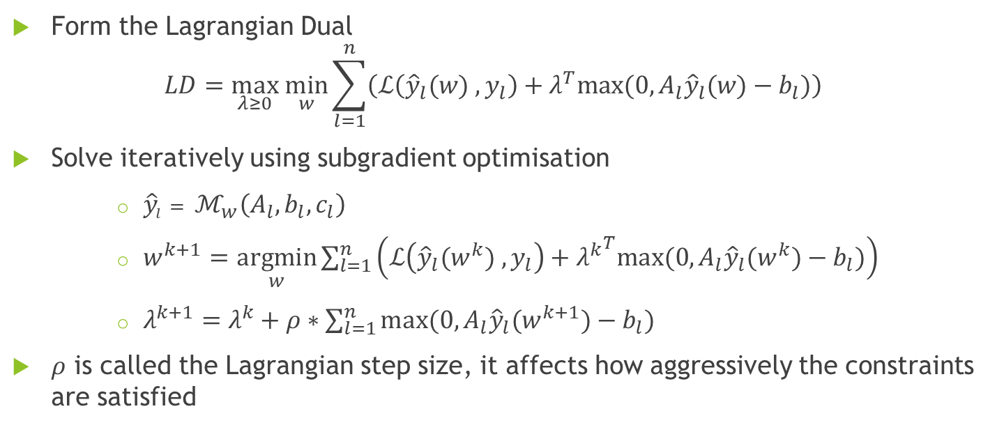
The Lagrangian Dual Framework (LDF)
Form the Lagrangian Dual
$$LD=\max_{λ≥0} \min_{w}\sum_{l=1}^{n}{\left(ℒ\left({\hat{y}}_{l}(w) ,y_{l}\right)+λ^{T}max⁡(0,A_{l}{\hat{y}}_{l}(w)−b_{l})\right)}$$
Solve iteratively using subgradient optimisation
${\hat{y}}_{l}= ℳ_{w}\left(A_{l},b_{l},c_{l}\right)$
$w^{k+1}=$ $\underset{w}{argmin}\sum_{l=1}^{n}{\left(ℒ\left({\hat{y}}_{l}(w^{k}) ,y_{l}\right)+{λ^{k}}^{T}max⁡(0,A_{l}{\hat{y}}_{l}(w^{k})−b_{l})\right)}$
$λ^{k+1}=λ^{k}+ρ∗\sum_{l=1}^{n}{max⁡(0,A_{l}{\hat{y}}_{l}(w^{k+1})−b_{l})}$
$ρ$ is called the Lagrangian step size, it affects how aggressively the constraints are satisfied
Notes:
After that we can form the Lagrangian dual, and solve using subgradient optimisation.
So in practice this is an iterative routine. We start with some initial weights and Lagrange multipliers. At each iteration we evaluate the model at each sample to get our predictions y_hat for each sample, and then update the weights by taking the minimum over the Lagrangian relaxation.
Then we evaluate the degree of constraint violation for each constraint, and then update the corresponding lagrange multipliers proportional to the degree of violation, multiplied by some value rho which is called the Lagrangian step size. The Lagrangian step size effectively says how aggressive we want to be in satisfying constraints, if you make it too large the lagrange multipliers are going to shoot up and the minimisation over the weights will be dominated by the constraints. In the other direction if it’s too small the Lagrange multipliers will stay small and the algorithm won’t be very incentivised to satisfy the constraints.

Slide 9
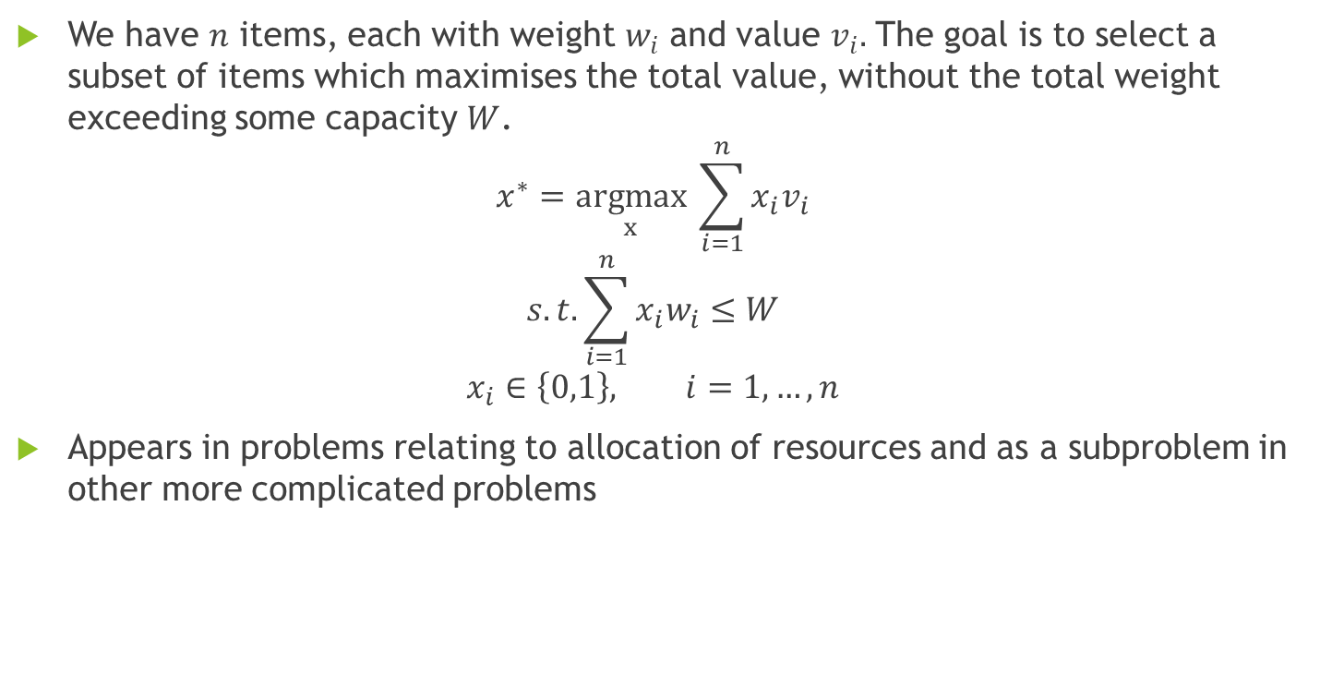
The Knapsack Problem
We have $n$ items, each with weight $w_{i}$ and value $v_{i}.$ The goal is to select a subset of items which maximises the total value, without the total weight exceeding some capacity $W$.
$$x^{∗}=\underset{x}{argmax} \sum_{i=1}^{n}{x_{i}v_{i}}$$
$$s.t. \sum_{i=1}^{n}{x_{i}w_{i}≤W}$$
$$x_{i}∈\left\{0,1\right\}, i=1,…,n$$
Appears in problems relating to allocation of resources and as a subproblem in other more complicated problems
Notes:
As a concrete example I’ve been looking at predicting solutions to the Knapsack problem. This is a classic problem in combinatorial optimisation. The basic statement is to imagine you have n items, and each of those items has a weight and a value associated with it. If you have bag or a knapsack with a maximum weight capacity W, what items do you put in the knapsack to maximise the total value without going over the weight limit of the knapsack.
It’s fairly straightforward to model this as in integer program. The decision variable x_i is 0 or 1 depending on whether the i^th item is placed in the knapsack, and then the objective function and the constraint concern the total weight and value of items in the knapsack
The knapsack problem and it’s variants, of which there are many, pop up a lot problems relating to resource allocation in particular and also commonly as a subproblem in more complicated

Slide 10
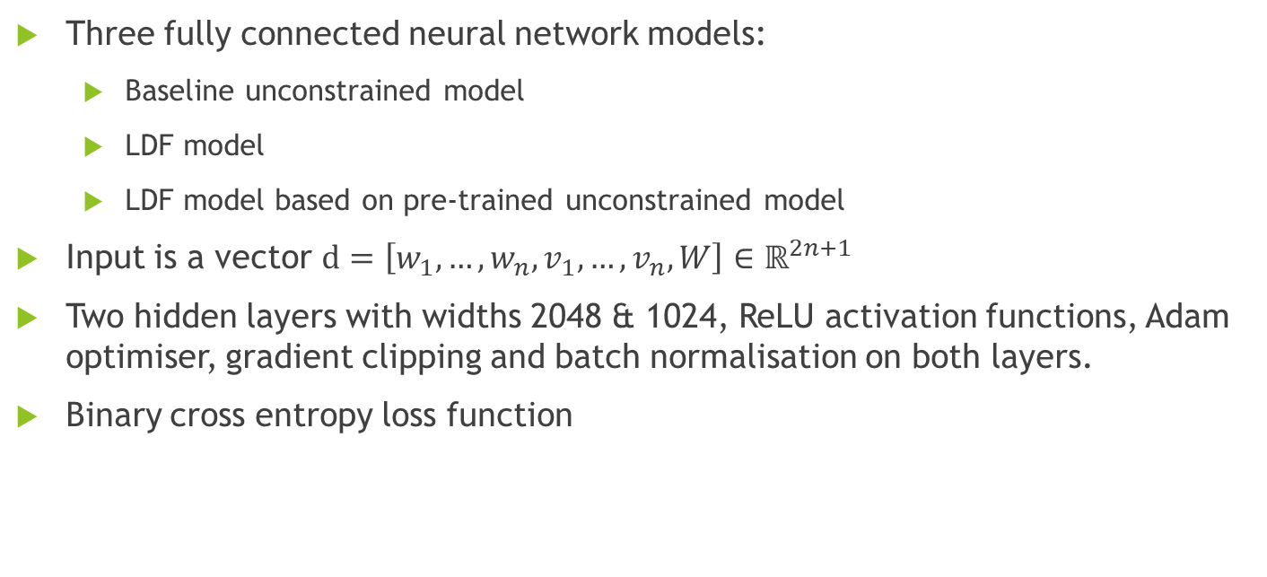
Predicting Knapsack Solutions with Neural Networks and the LDF
Three fully connected neural network models:
Baseline unconstrained model
LDF model
LDF model based on pre-trained unconstrained model
Input is a vector $d=\left[w_{1},…,w_{n},v_{1},…,v_{n},W\right]∈ℝ^{2n+1}$
Two hidden layers with widths 2048 & 1024, ReLU activation functions, Adam optimiser, gradient clipping and batch normalisation on both layers.
Binary cross entropy loss function
Notes:
As my ML model I used neural networks. I’ve looked at three different networks. The first is a baseline, unconstrained neural network with no attempt at enforcing constraint satisfaction. The second implements the LDF. The third also implements the LDF, but is uses the fully trained unconstrained model as a starting point for training.
In terms of the structure of the networks, the input is all the data stacked into a vector, which is all the weights, values and the capacity for a single knapsack instance. The models themselves are fairly standard, they have two hidden layers with widths of 2048 & 1024 respectively and Relu activation functions. For training I used the Adam optimiser, batch normalisation on both layers and gradient clipping. Batch normalisation and gradient clipping are both really important and I found that results were pretty poor without those.
And then on the output I used the binary cross entropy loss function, since what we’re actually doing is multi-output binary classification

Slide 11
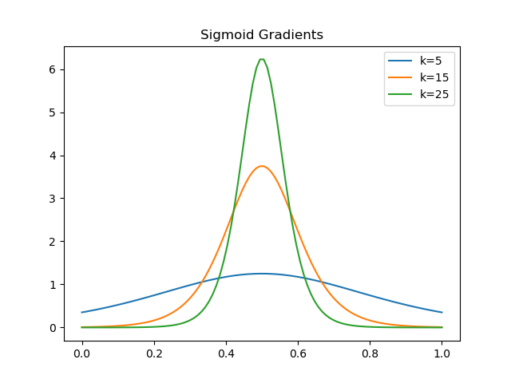
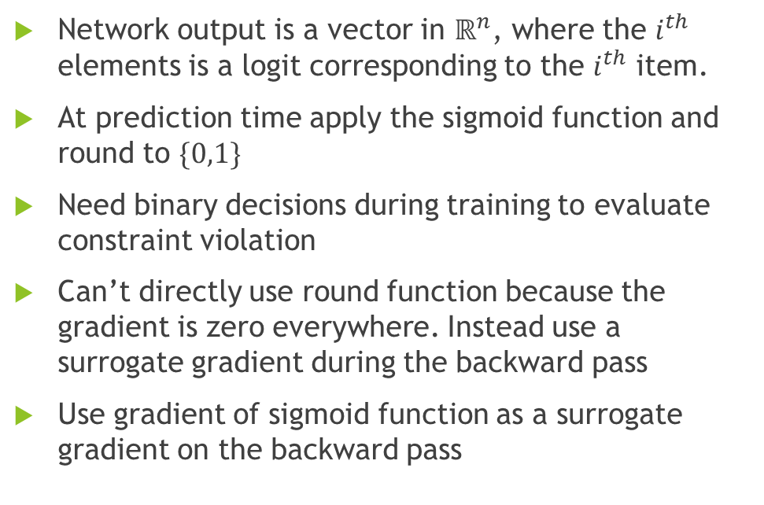
Output Decoding
Network output is a vector in $ℝ^{n}$, where the $i^{th}$ elements is a logit corresponding to the $i^{th}$ item.
At prediction time apply the sigmoid function and round to $\{0,1\}$
Need binary decisions during training to evaluate constraint violation
Can’t directly use round function because the gradient is zero everywhere. Instead use a surrogate gradient during the backward pass
Use gradient of sigmoid function as a surrogate gradient on the backward pass
Notes:
On the output side the network spits out a vector in R^n where the i^th element is a logit that corresponds to the i^th item. Since we’re only interested in the binary decision variables that correspond to including/excluding items in the knapsack, we need some way to decode this output.
For generating predictions the easiest way is to apply the sigmoid function, which will squish the outputs into the range [0,1], and then round them to get our binary variables. The binary variables are also needed during training because we need to be able to evaluate degree of constraint violations. We actually can’t directly use the round function for this, the problem being that the round function has a gradient of zero everywhere, which means that during the backward pass of the network there won’t be any useful information flowing back from the constraint portion of the loss function.
The solution to this is to use a surrogate gradient, which effectively means substituting in the gradient of a new function in during backpropogation. I’ve use the gradient of the sigmoid function, which you can see plotted here parameterised by k. The parameter k controls how tightly the function is distributed around the centre. The idea is that close to one half small changes in input can cause the round function to jump between 0 and 1, so this is where the gradient is highest. In practice I found that training was fairly robust to changes in k. Varying k within the range [5,35] didn’t have much effect on results.

Slide 12
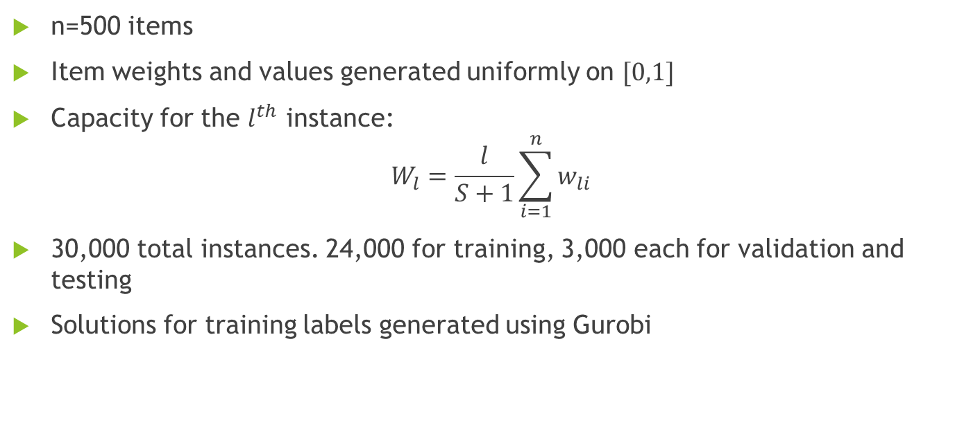
Instance Generation
n=500 items
Item weights and values generated uniformly on $[0,1]$
Capacity for the $l^{th}$ instance:
$$W_{l}=\frac{l}{S+1}\sum_{i=1}^{n}{w_{li}}$$
30,000 total instances. 24,000 for training, 3,000 each for validation and testing
Solutions for training labels generated using Gurobi
Notes:
In terms of instance generation, I used instances with 500 items. The weights and values for each item are distributed uniformly on [0,1]. These are called uncorrelated instances since the weights and values are uncorrelated, but there are other ways to go about this. People often look at correlated instances where the value of an item is proportional in some way to the weight which is something you might see a lot in practice.
For the capacities in the dataset, you want to think about capacities relative to the total weight of the items in that instance, and that will be something of a proxy for instance difficulties. So naturally you want a good range from instance in which the capacity is a small portion of the total weight to ones in which the capacity is larger than the total weight.
I’ve used a total of 30,000 instances, of which 24,000 are used for training, and then 3,000 allocated to the validation and test sets

Slide 13
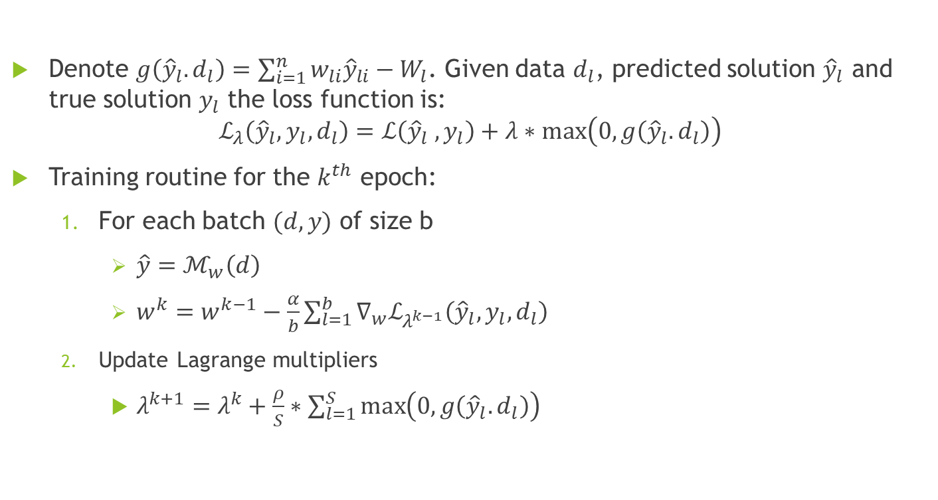
LDF Formulation
Denote $g\left({\hat{y}}_{l}.d_{l}\right)=\sum_{i=1}^{n}{w_{li}{\hat{y}}_{li}}−W_{l}$. Given data $d_{l}$, predicted solution ${\hat{y}}_{l}$ and true solution $y_{l}$ the loss function is:
$$ℒ_{λ}\left({\hat{y}}_{l},y_{l},d_{l}\right)=ℒ\left({\hat{y}}_{l} ,y_{l}\right)+λ∗max\left(0,g\left({\hat{y}}_{l}.d_{l}\right)\right)$$
Training routine for the $k^{th}$ epoch:
For each batch $(d,y)$ of size b
$\hat{y}=ℳ_{w}\left(d\right)$
$w^{k}=w^{k−1}−\frac{α}{b}\sum_{l=1}^{b}{∇_{w}ℒ_{λ^{k−1}}\left({\hat{y}}_{l},y_{l},d_{l}\right)}$
Update Lagrange multipliers
$λ^{k+1}=λ^{k}+\frac{ρ}{S}∗\sum_{l=1}^{S}{\max\left(0,g\left({\hat{y}}_{l}.d_{l}\right)\right)}$
Notes:
For the LDF formulation, just like before I’ll use a function g to describe the inequality constraint. The main thing to note is that y_hat_l_i denotes the whether or not the ith item is included in the predicted solutions for the lth sample. And then we’ll wrap everything up into one loss function for our Lagrangian relaxation, and now because there’s only one constraint lambda is just scalar value.
For the training routine we start with some initial weights and lagrange multipliers. Then at each epoch get the predicted solutions from the model, calculate the gradient of the loss function with respect to the weights and then update the weights. Hopefully this part should look familiar since it’s an informal description of stochastic gradient descent. And then after that the Lagrange multipliers are updated based on the constraint violation
I will point out that before when I described the LDF the weights were updated by minimising over the Lagrangian relaxation, whereas here we only run through the full training data once for gradient descent which won’t be enough to converge to a minimum. You can implement some sort of interleaving so that you don’t update the Lagrange multipliers on every epoch. I did experiment with that a bit, a fixed interleave didn’t seem particularly effective but it might be a matter of tuning the Lagrangian step size, and I think there’s a case for allowing the network more time to converge with updating the lagrange multipliers on earlier epochs in particular.

Slide 14
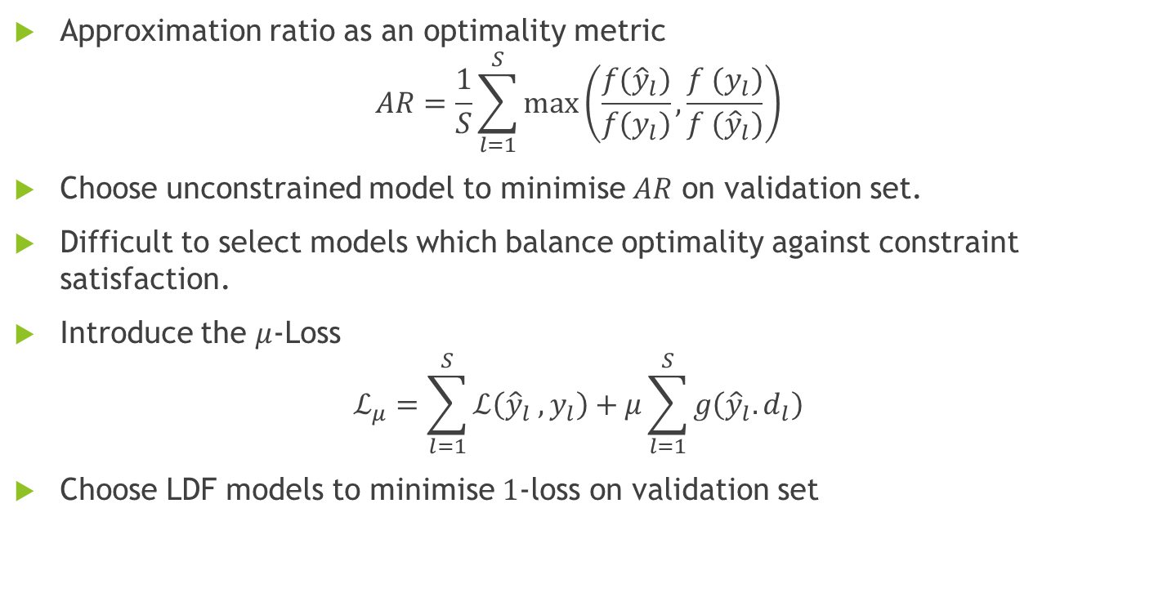
Model Validation
Approximation ratio as an optimality metric
$$AR=\frac{1}{S}\sum_{l=1}^{S}{\max\left(\frac{f({\hat{y}}_{l})}{f(y_{l})},\frac{f (y_{l})}{f ({\hat{y}}_{l})}\right)}$$
Choose unconstrained model to minimise $AR$ on validation set.
Difficult to select models which balance optimality against constraint satisfaction.
Introduce the $μ$-Loss
$$ℒ_{μ}=\sum_{l=1}^{S}{ℒ\left({\hat{y}}_{l} ,y_{l}\right)}+μ\sum_{l=1}^{S}{g\left({\hat{y}}_{l}.d_{l}\right)}$$
Choose LDF models to minimise $1$-loss on validation set
Notes:
In terms of model validation, we care about the optimality of predicted solutions, how often predictions violate the capacity constraint and also by how much.
For measuring optimality the approximation ratio is a convenient. f(y_hat_l) is the objective value for the predicted solution, while f(y_l) is the true optimal objective value, so it’s just measuring how far away our predictions are away from optimal, the closer to one the better. For unconstrained baseline model I’ve chosen the model which minimised the approximation ratio on the validation set during training.
Things are a bit more complicated for the LDF models. If you optimise for the approximation ratio you may get models with very poor constraint satisfaction, and you also can’t use the loss to select models, since the Lagrange multipliers are constantly increasing making comparisons across training epochs unreliable. The solution I settled on was to introduce a mu loss, which is basically just the same loss function but fixing the Lagrange multipliers to a set value. I found that choosing models which minimised the 1-loss gave reasonable results for knapsack.

Slide 15
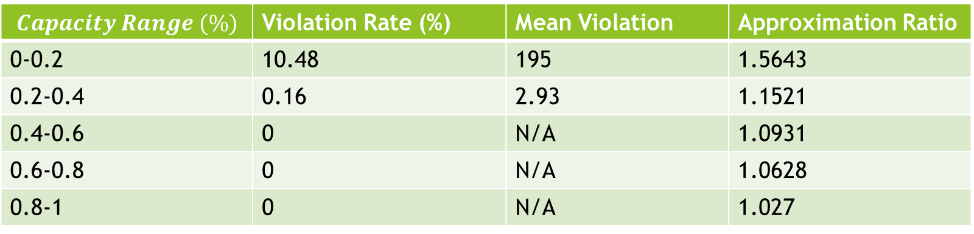
Results
Model | Violation Rate (%) | Approximation Ratio
Unconstrained | 84.9 | 1.0703
LDF | 2.1 | 1.1811
Pre-trained LDF | 2.9 | 1.177
Model Test Set Performance Comparison
$$Capacity Range (\%)$$ | Violation Rate (%) | Mean Violation | Approximation Ratio
0-0.2 | 10.48 | 195 | 1.5643
0.2-0.4 | 0.16 | 2.93 | 1.1521
0.4-0.6 | 0 | N/A | 1.0931
0.6-0.8 | 0 | N/A | 1.0628
0.8-1 | 0 | N/A | 1.027
LDF Model Performance Breakdown by Capacity Relative to Total Item Weight
Notes:
On this slide we’ve got the results on the test set. First up is the unconstrained model. It shows reasonably strong performance in terms of the approximation ratio, but it very consistently violates the capacity constraint in 85% of instances. Both of the LDF models are worse in terms of the approximation ratio but only violate the capacity constraint in 2-3% of instances which is a massive improvement over the baseline model.
And just to zoom in a bit I also have the results for the LDF model broken down into capacity quintiles. The capacity ranges here are the capacity as a proportion of the total weight in the instance. It’s clear that poor performance of the model is concentrated really heavily in low capacity instances where the capacity is up to 20% of the total instance weight. For higher capacity instances the performance is really strong, the capacity constraint is never violated and the approximation ratio is low.
7% and 18%

Slide 16
Computation Times
 | Unconstrained | Pre-trained LDF | LDF
Epochs | 16 | 46 | 250
Time (Minutes) | 0.7 | 2.6 | 16
Training LDF models takes approximately 46% longer per epoch
Neural networks generate predictions in 1ms
Gurobi solves the same instances in an average of 5.7ms
All experiments run on an Intel i5-11400 processor
Notes:
What’s also of interest is the time taken for training these models and generating predictions, especially as compared to traditional solvers. So in terms of training time, the unconstrained and pre-trained LDF models tend to converge much faster than the normal LDF models, which I found to be a big benefit of pre-training before applying the Lagrangian Dual Framework. Using the LDF increases the time per epoch by around 46%, which is mostly time spent evaluating the constraints and updating the Lagrange multipliers. This could probably be optimised further and for larger models that take longer to train I’d expect the extra time spent to be much smaller, proportionally.
For prediction times, the ML models can produce predictions in 1ms, averaged over all 30,000 instances. On that the same set of instances Gurobi can generate solutions in 5.7ms on average. There’s a few caveats here. The first being that these results will be somewhat hardware dependent, for reference I was running all these experiments on an 11th gen intel i5 CPU. I’d expect training and generating predictions to be faster on GPU, although in practice the usefulness of any speedup you get in generating predictions is going to be contingent on actually needed to generate a lot of solutions in parallel. If you only need one prediction every five minutes it might not help you much. Another caveat is that I’ve used Gurobi as a general integer programming solver, there are specialised algorithms for solving Knapsack that would likely be much faster.
But, broadly speaking for reasonably difficult IP problems I’d expect neural network models to be faster at generating solutions
Note that pre-trained LDF time includes training baseline unconstrained model. 2.625 seconds per epoch vs 3.84

Slide 17
Next Steps
Class scheduling problem – Schedule classes for minimum cost, minimise electricity usage from grid, solar power & batteries available
Much higher complexity than Knapsack:
Orders of magnitude more decision variables and constraints
Continuous decision variables to track battery charge
Equality constraints which must be strictly satisfied
Difficult to generate training data, need to use Bunya HPC platform
Notes:
Outside of the Knapsack Problem I’ve been looking at another mixed integer linear programming problem that’s a fair bit more complex than the Knapsack problem. I won’t describe the full problem, but at it’s core it’s class scheduling problem, where the classes have an associated electricity usage. The goal is to minimise the cost associated with the class schedule where a large portion of the cost is coming from electricity usage, and you have solar power and batteries that can be used instead of grid power. And there are other complications in the model like having one-off and recurring classes to schedule which makes finding solutions more difficult.
Compared to the Knapsack problem this requires orders of magnitude more decision variables and constraints to model. It also has continuous decision variables which are used to track the battery usage, which makes it a mixed integer linear programming problem. And it also has equality constraints which need to be strictly satisfied for solutions to make any sense since they relate to physical laws.
One advantage of looking at Knapsack was that I could generate training data fairly easily. For the class scheduling problem the fastest solving method I’ve found is column generation where the columns are feasible schedules. On my hardware I can usually solve smaller instances to about a 1% optimality gap within around 10 minutes, which isn’t too bad but it won’t be feasible to generate a full training dataset at that speed, and I also have issues with memory usage. I have 16GB of ram and it can be hard to predict when Gurobi is going to use all of it for the model. So because of that I’m currently looking at using the university’s high performance computing platform called Bunya to help generate training data.

